Slide 1
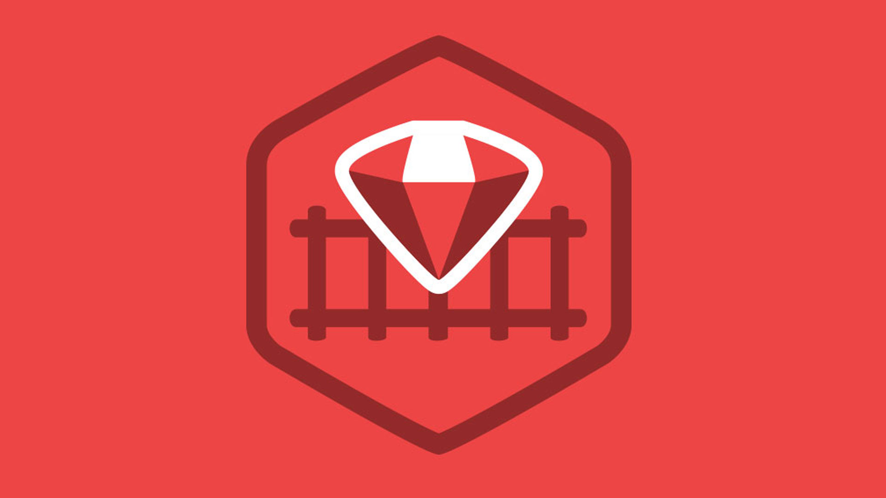
Ruby on Rails

Slide 2
About today…
Ruby on Rails
Installation
File System
MVC Architecture

Slide 3
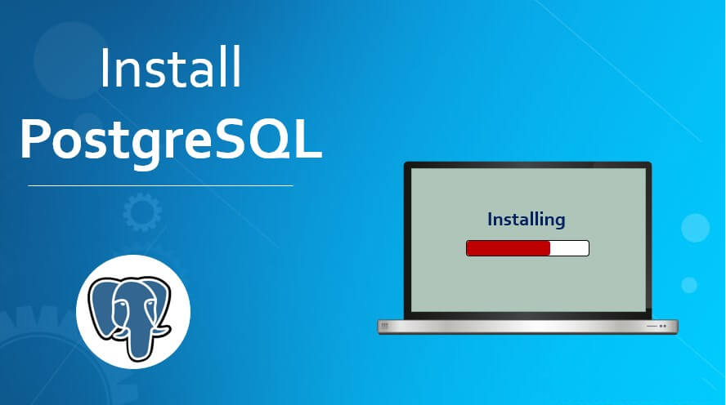

Slide 4
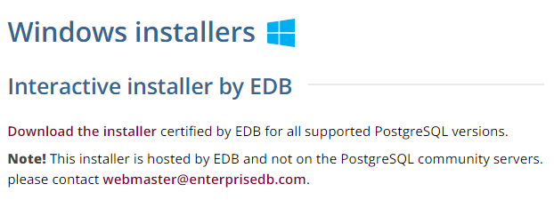
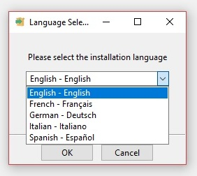
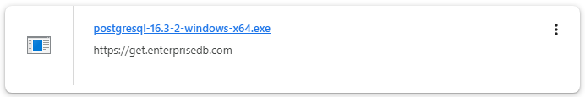
Installing PostgreSQL
Follow the URL :
https://www.postgresql.org/download/windows/

Slide 5
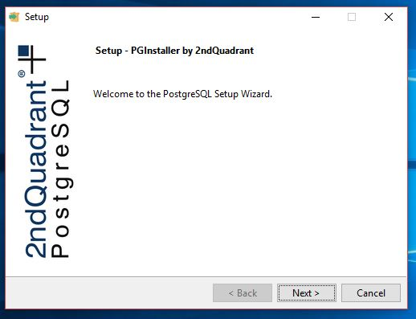
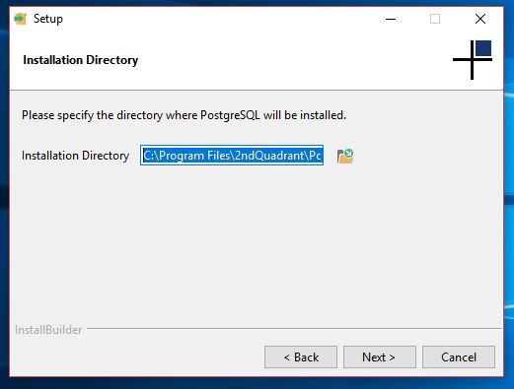
Installing PostgreSQL

Slide 6
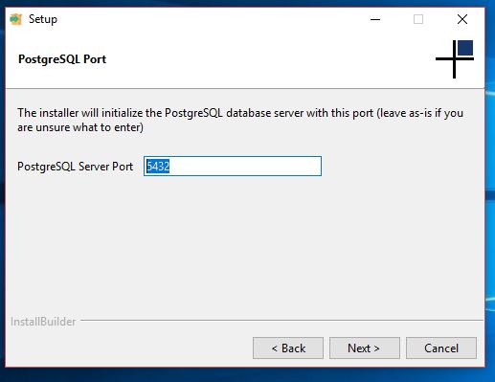
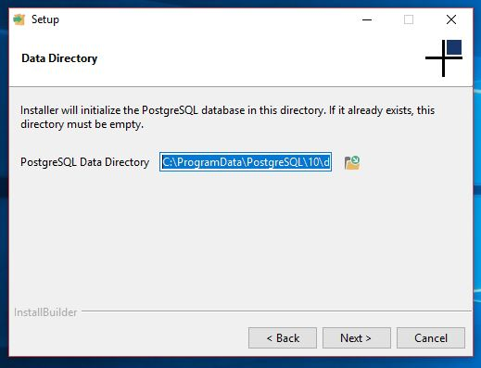
Installing PostgreSQL

Slide 7
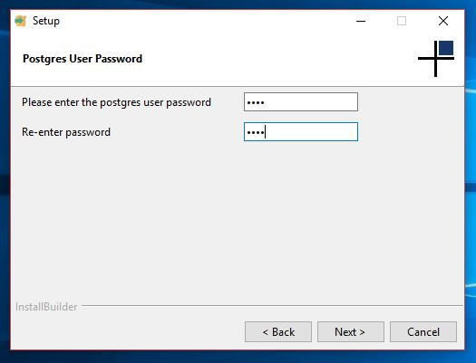
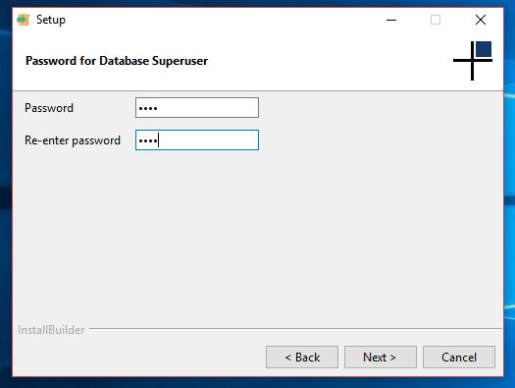
Installing PostgreSQL

Slide 8
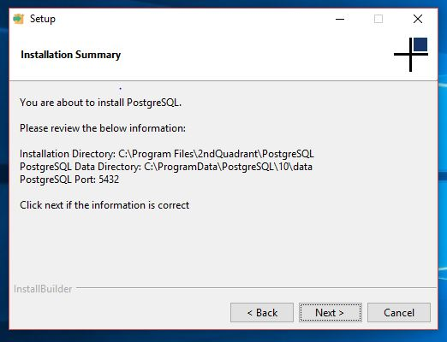
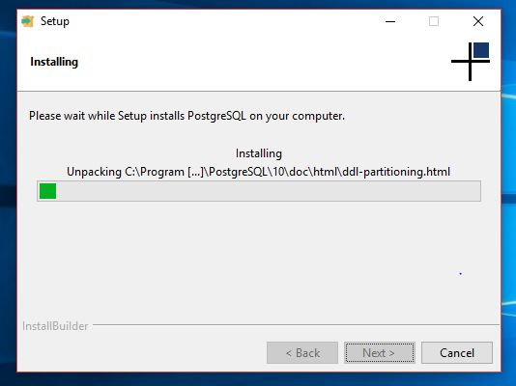
Installing PostgreSQL

Slide 9
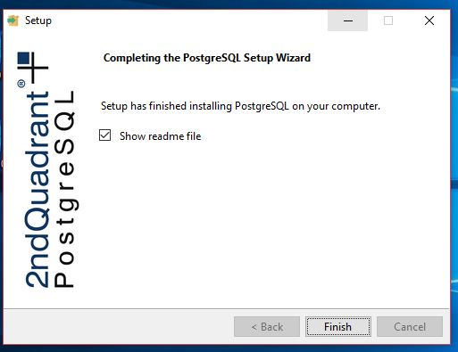
Installing PostgreSQL
Add PostgreSQL path to your system PATH C:\Program Files\PostgreSQL\{version}\bin

Slide 10
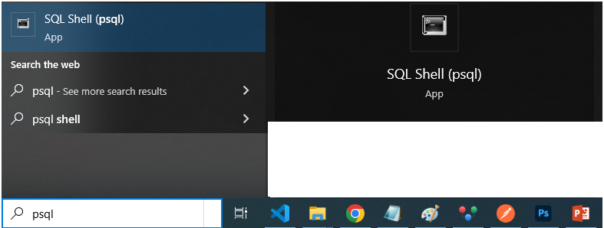
Accessing PostgreSQL

Slide 11
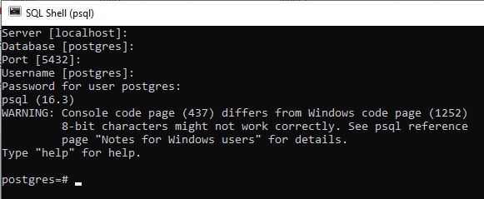
Connecting to PostgreSQL

Slide 12
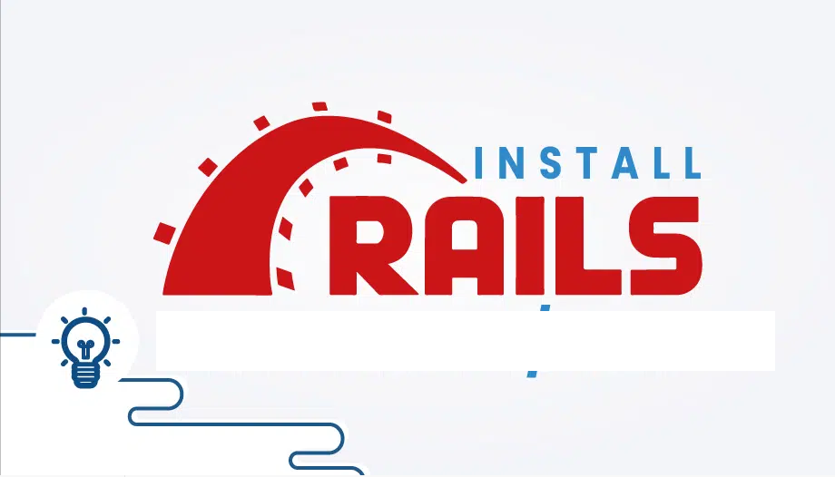

Slide 13
ROR Installation Prerequisites
Make sure about the installation of Ruby
Make sure about the installation of Gem

Slide 14
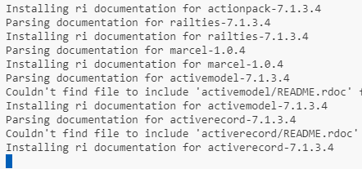


Install Rails
Write the command to install rails
After installation, you can verify Rails installation by checking its version

Slide 15
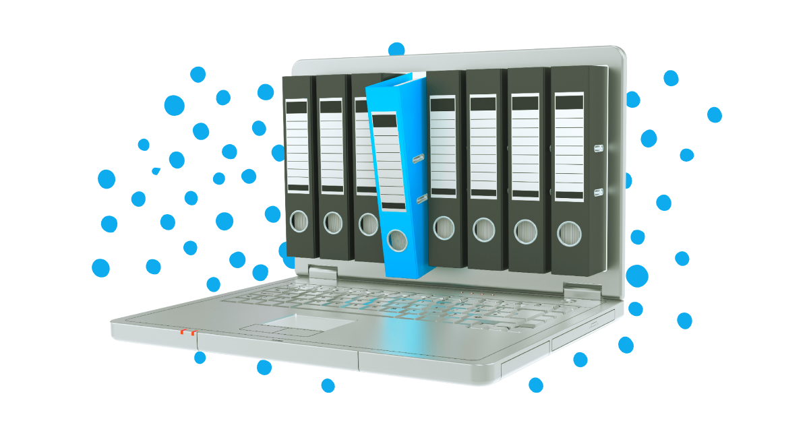

FILE SYSTEM

Slide 16
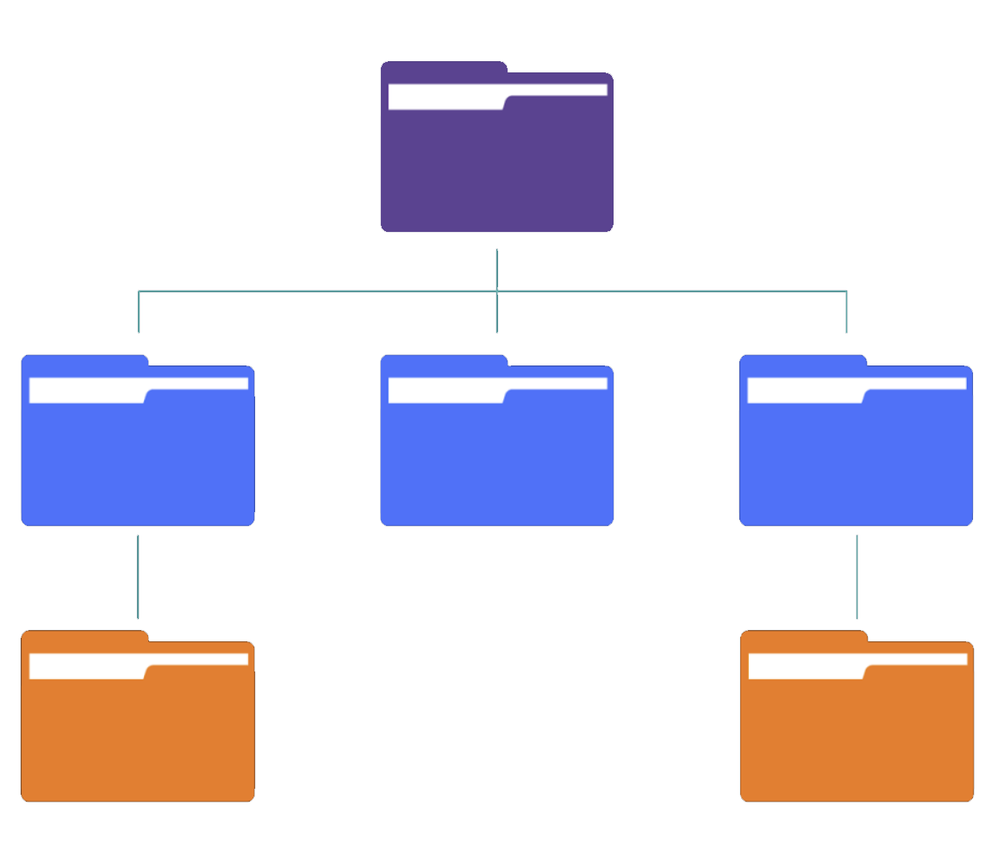
Basic File Structure
app/
Contains the core application code
config/
Configuration files for the application
db/
Database schema and migrations
public/
Static files accessible by the public
Gemfile
Specifies gem dependencies

Slide 17
app/ directory
config/ directory
assets/
JavaScript, CSS, and image assets
database.yml
Database configuration
controllers/
Handles application logic
routes.rb
Defines application routes
models/
Defines data structures
application.rb
Global application settings
views/
User interface templates
public/ directory
db/ directory
index.html
Default landing page
migrate/
Database migrations
404.html
Error Pages
500.html
schema.rb
Database schema definition
seeds.rb
Seed data for database initialization
Gemfile
Lists gem dependencies and versions

Slide 18
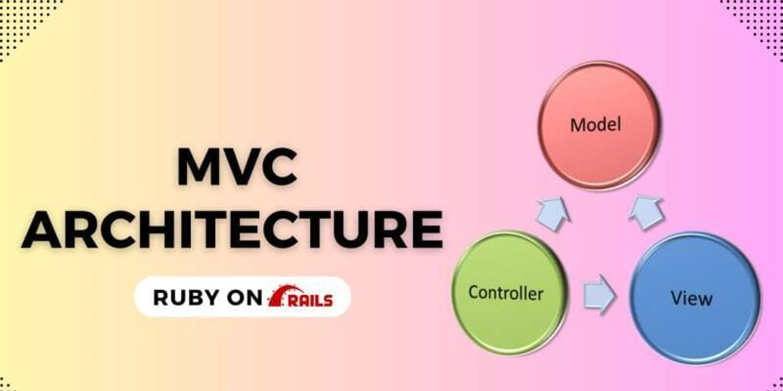

Slide 19
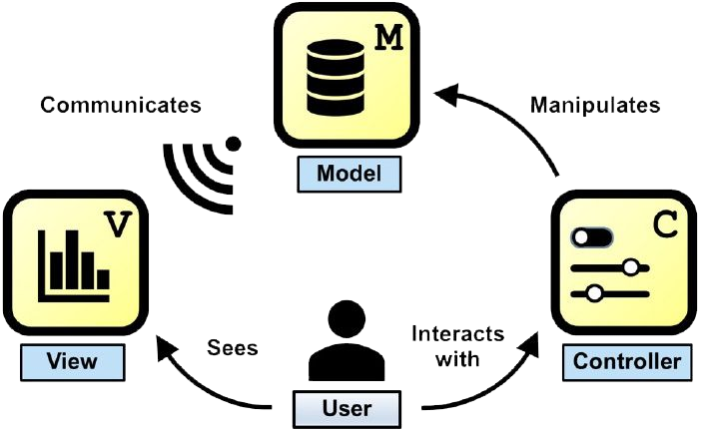
What is MVC?
MVC separates application concerns
Data logic and manipulation
User interface presentation
Application logic and routing

Slide 20
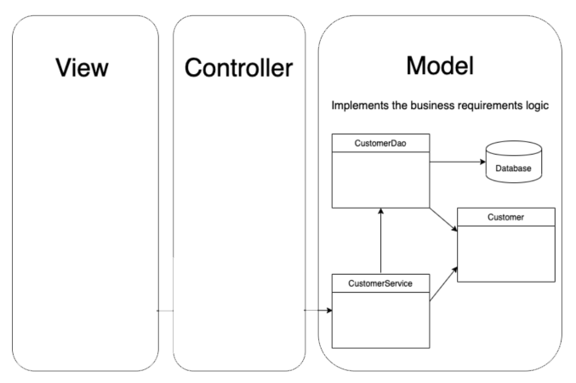
Model Layer
Handles data manipulation and storage
Represents database tables
Business logic resides here

Slide 21
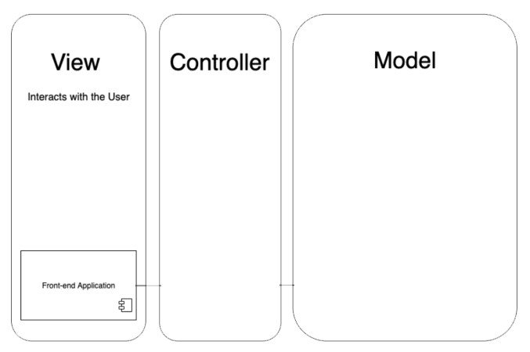
View Layer
Renders user interface elements
Uses templates (ERB or Haml)
Receives data from controllers

Slide 22
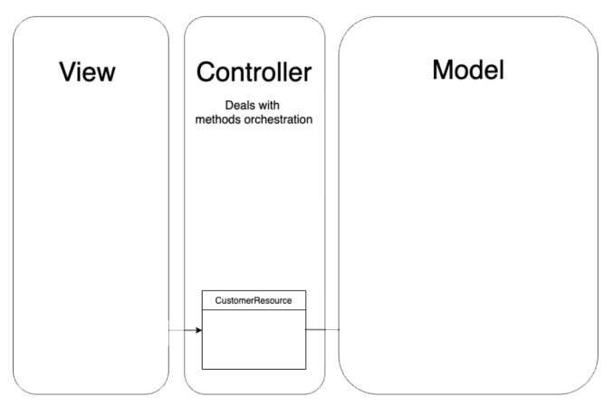
Controller Layer
Handles user requests and routing
Communicates with models and views
Processes input and sends output

Slide 23
Request Flow
Router maps request to controller action
1
2
Router directs to ‘ProductsController#index’
Client sends request (HTTP)
Controller interacts with model and renders view
User requests ‘/products’
Controller fetches data from ‘Product’ model
4
Response sent back to client
3
View renders HTML response

Slide 24
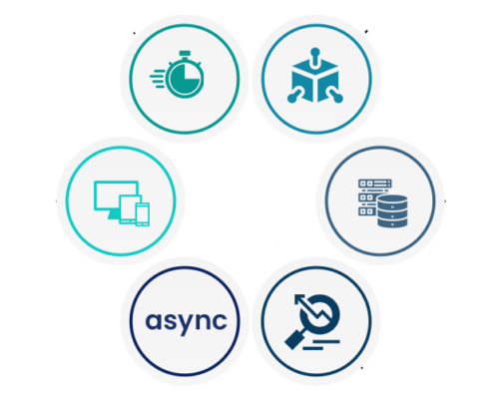
Advantages of MVC
Separation of concerns improves maintainability
Facilitates parallel development
Supports code reusability

Slide 25


Slide 26

What does MVC stand for in Ruby on Rails?
Which MVC component is responsible for handling the application's business logic?
In the MVC architecture, where is the user interface code typically placed?
Which part of the MVC pattern in Ruby on Rails interacts with the database?
How do you define a new route in a Ruby on Rails application?
Which file in a Rails application defines the database schema?
Which directory contains the asset files (like JavaScript, CSS, and images) in a Rails application?

Slide 27

Task 1
Discuss different advantages of MVC over the traditional development approach.

